Slide 1
INTRODUCTION
In today's era computers have become a vital component of any enterprise for giving it proper directions and extensive control of the various activities to attain business objectives. Computer applications have affected scientific & commercial knowledge.The information System of the old times totally differs from the todays. It isautomation system of a book shop or any information system. In the previousages the process of maintaining data and record seemed very difficult. Now days,computer is very essential component. The implementation of computer basedInformation System can be depicted as the ease in handling and maintaining thedata bank of any size.Our project is on Book Shop Management System whichdeals with almost all the information of Book Shop It keeps the database of customer records and publishing records. It also keeps the author list, charges and Book-title list.The business of Book Shop is spread all over the world. A large record should be maintained in a proper manner for running of Book Shop. The proposed system is a window based menu driven system. It reduces the paper works, time needed for doing various tasks etc. Our project upholds the accuracy of data.

Slide 2
HARDWARE & SOFTWARE REQUIREMENTS
Computer or laptop for making project files.
Computer configuration - intel i3 processor , 500 gb harddisk , 8 ram
Python IDLE installed in computer for writing python script
MySQL Server installed for storing data of project
MySQL connector installed for connecting python idle with mySQL server
Internet connection must be present for installing softwares given below
Ms word for creating project file for submission.

Slide 3
CODING OF “BOOKSHOP MANAGEMENT SYSTEM”
#CONNECT DATABASE
import mysql.connector as a
passwd=str(input("DATABASE PASSWORD : "))
con = a.connect(host="localhost",
user="root",passwd = passwd)
# SELECT DATABASE IF EXIST
c = con.cursor()
c.execute("show databases")
dl = c.fetchall()
dl2 = []

Slide 4
for i in dl:
dl2.append(i[0])
if 'bshop' in dl2:
sql = "use bshop"
c.execute(sql)
else: #CREATE DATABASE IF DOES NOT EXIST
sql1 = "create database bshop"
c.execute(sql1)
sql2 = "use bshop"
c.execute(sql2)
sql3 = """create table Book ( Name varchar(50), Author varchar(50), CostPrice integer, SellPrice integer, Date varchar(20))"""
c.execute(sql3)
sql4 = """create table Customer (Name varchar (20), Book varchar(20) Payment varchar(8), Date varchar(20), Phone varchar(20))""“
c.execute(sql4)

Slide 5
sql5 = """create table Bills (Detail varchar(20), Cost integer, Date varchar(20)"""
c.execute(sql5)
sql6 = """create table Worker (Name varchar(100), Work(20), Salary varchar(20)"""
c.execute(sql5)
con.commit()
#SYSTEM PASSWORD LOGIN
def signin():
print("\n")
print(" ---------->>>>>>>>Welcome, Bhubaneswar Book Shop [ BBS ]<<<<<<<-----------------")

Slide 6
print("\n")
p = input("System Password : ")
if p == "abs111":
options()
else:
signin()
# PROJECT WORKING OPTIONS
def options():
print("""
AGRA BOOK SHOP
..........................................................................................
1. Add Book 5. Display Books
2. Sell Book 6. Display Payments
3. Add Bill 7. Display Bills
4. Add Worker 8. Display Workers
...........................................................................................
""")

Slide 7
choice = input("Select Option : ")
while true:
if (choice==‘1’):
AddBook()
elif (choice==‘2’):
SellBook()
elif (choice==‘3’):
AddBill()
elif (choice==‘4’):
AddWorker()
elif (choice=='5'):
dBook()
elif (choice=='6'):

Slide 8
dPayments()
elif (choice=='7'):
dBills()
elif (choice==‘8'):
dWorker()
else:
print("Enter Again...........“)
options()

Slide 9
def AddBook():
n = input("Name : ")
a = input("Author : ")
c = input("Cost Price : ")
s = input("Selling Price : ")
d = input("Date : ")
data = (n,a,c,s,d)
sql = 'insert into Book values(%s,%s,%s,%s,%s)'
c = con.commit()
print("Data Inserted Successfully")
options()

Slide 10
def SellBook():
n = input("Name : ")
s = input("Book : ")
py= input(“Payment : “)
d = input("Date : ")
p = input("Phone : ")
data = (n,s,py,d,p)
sql = 'insert into Customer values(%s,%s,%s,%s,%s)'
c = con.cursor()
c.execute(sql,data)
con.commmit()
print("Data Inserted Successfully")
options()

Slide 11
def AddBill():
dt = input("Detail : ")
c = input("Cost : ")
d = input("Date : ")
data =(dt,c,d)
sql = 'insert into Bills values(%s,%s,%s)'
c = con.cursor()
c.execute(sql,data)
con.commit()
print("Data Inserted Successfully")
options()

Slide 12
def AddWorker():
n = input("Name : ")
w = input("Salary : ")
data = (n,w,s)
sql = 'insert into Worker values(%s,%s,%s)'
c = con.cursor()
c.execute(sql,data)
con.commit()
print("Data Inserted Successfully")
options()

Slide 13
def dBooks():
sd = input("Date : ")
sql = 'select * from Book'
c = con.cursor()
c.execute(sql)
d = c.fetchall()
for i in d:
if i[4] == sd:
print("Name : ",i[0],"Author : ",i[1],"Cost : ",i[2],"Buy : ",i[3],"Date : ",i[4])
print("..........................................................................")
options()

Slide 14
def dPayments():
sd = input("Date : ")
sql = 'select * from Customer'
c = con.cursor()
c.execute(sql)
d = c.fetchall()
for i in d:
if i[3] == sd:
print("Name : ",i[0],"Book : ",i[1],"Payment : ",i[2],"Date : ",i[3],"Phone : ",i[4])
print("...........................................................................")
options()

Slide 15
def dBills():
sd = input("Date : ")
sql = 'select * from Bills'
c = con.cursor()
c.execute(sql)
d = c.fetchall()
for i in d:
print("Detail : ",i[0],"Cost : ",i[1],"Date : ",i[2])
print("...........................................................................")
options()

Slide 16
def dWorker():
sql = 'select * from Worker'
c = con.cursor()
c.execute(sql)
d = c.fetchall()
for i in d:
print("Name : ",i[0],"Worker : ",i[1],"Salary : ",i[2])
print("...........................................................................")
options()
signin()

Slide 17
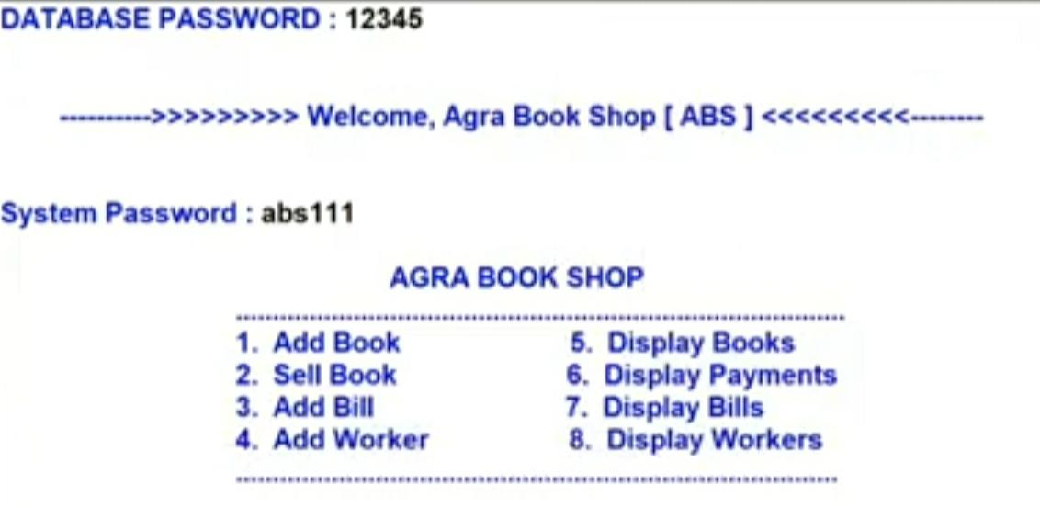
OUTPUT SCREENS
LOGIN AND DISPLAY MENU

Slide 18
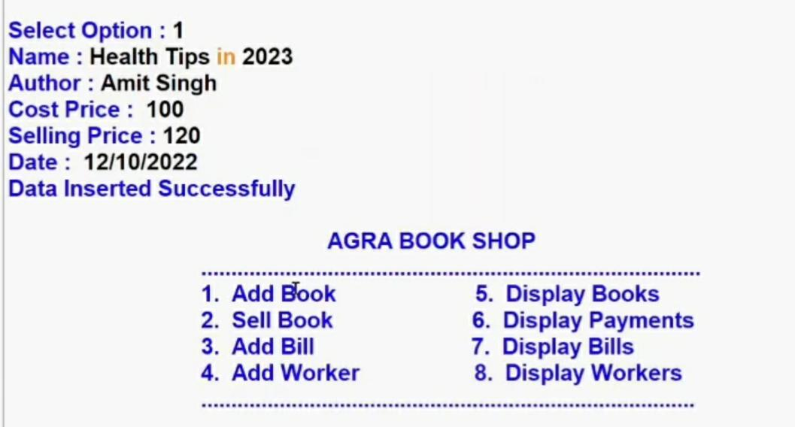
ADDING BOOK

Slide 19
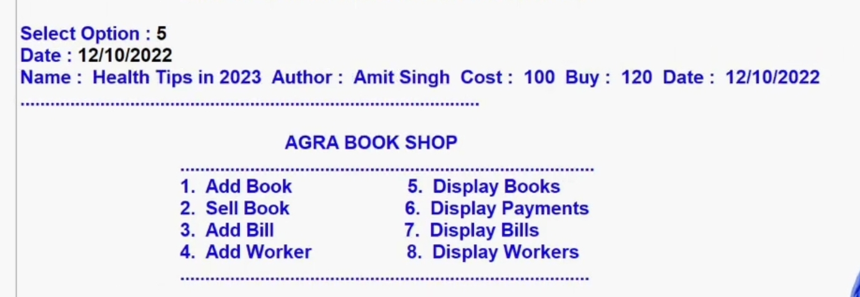
DISPLAY BOOKS

Slide 20
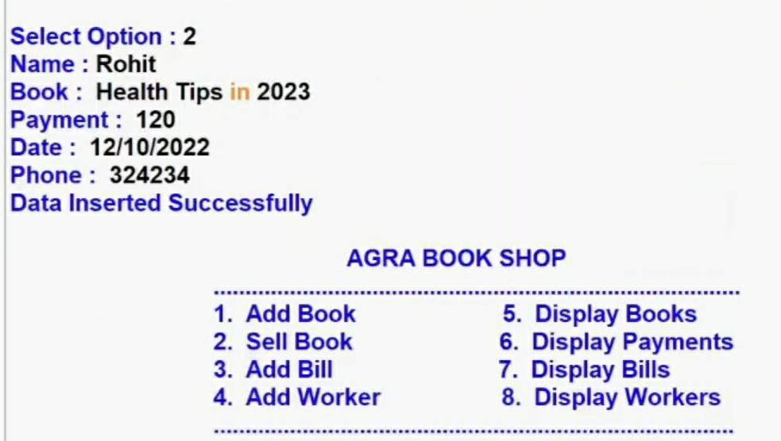
SELL BOOK

Slide 21
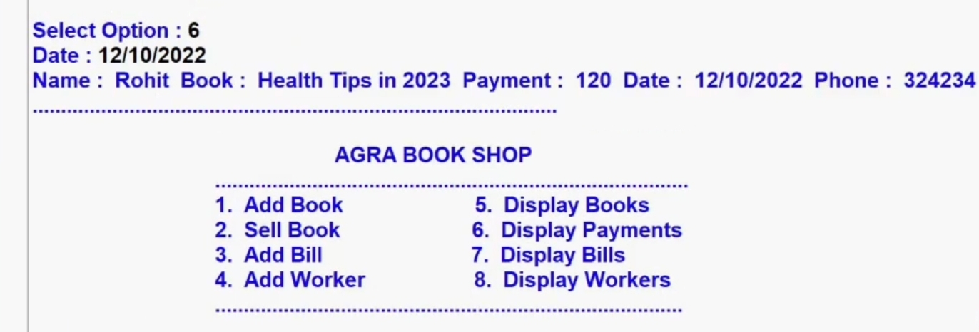
DISPLAY PAYMENTS

Slide 22
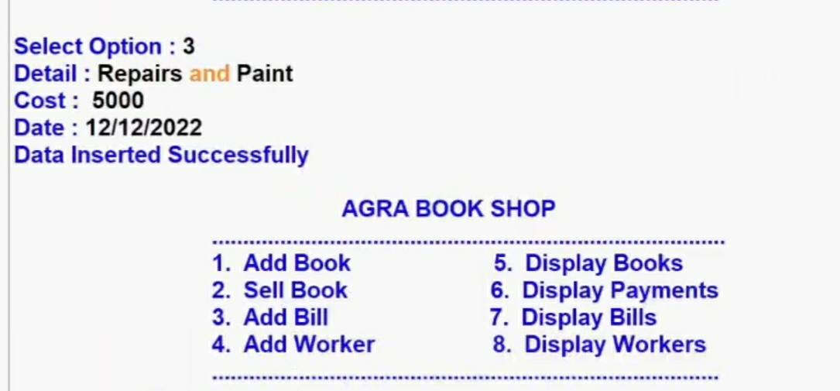
ADD BILL

Slide 23
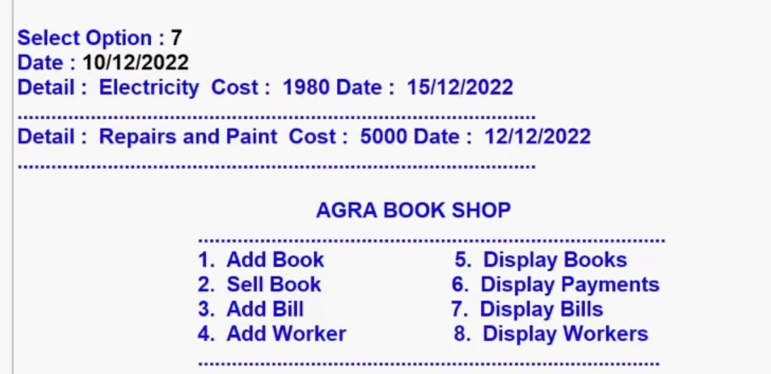
DISPLAY BILLS

Slide 24
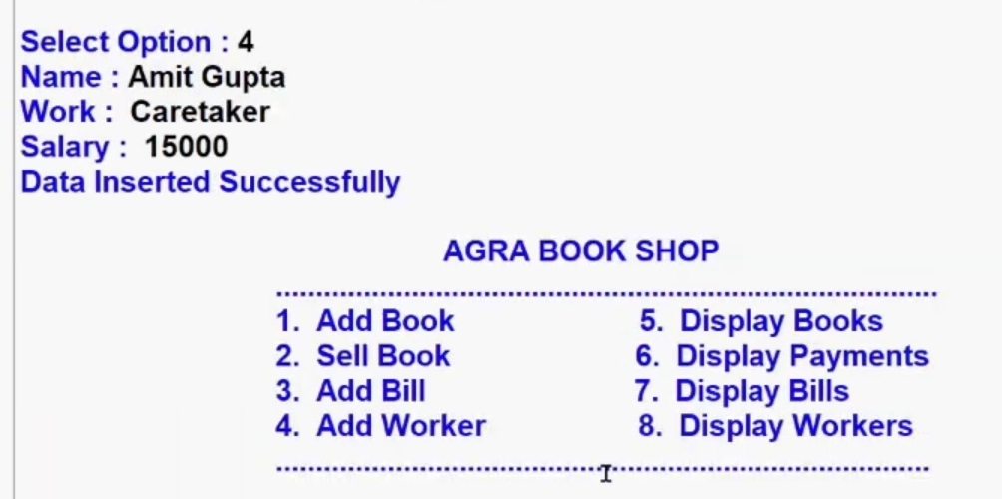
ADD WORKER

Slide 25
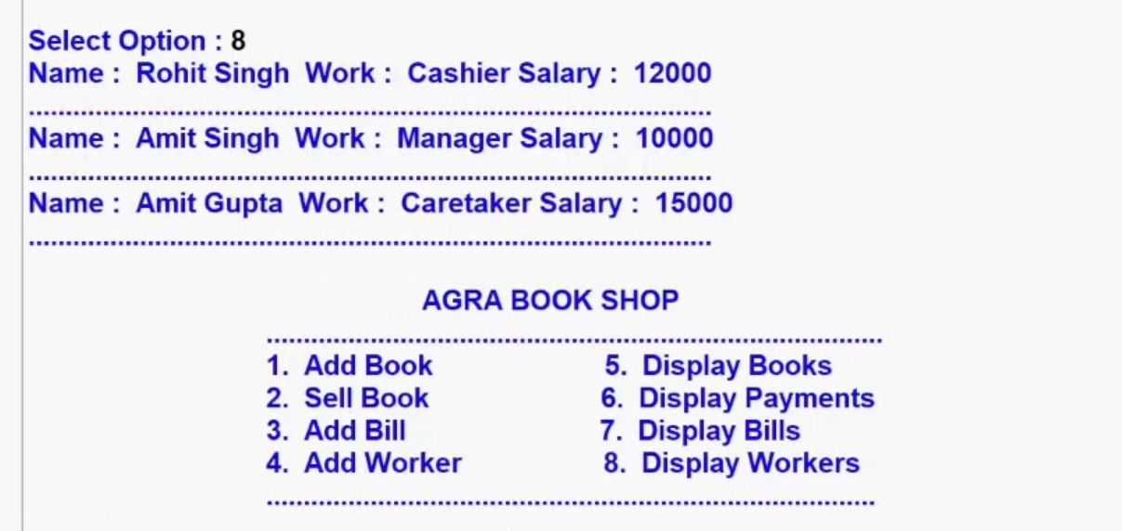
DISPLAY WORKERS

Slide 26
CONCLUSION
In this project, the user is provided with an e- commerce web site that can be used to buy books online.
MySQL was used as back-end database since it is one of the most popular open source databases, and it provides fast data access, easy installation and simplicity. A good shopping cart design must be accompanied with user-friendly shopping cart application logic. It should be convenient for the customer to view the contents of their cart and to be able to remove or add items to their cart.

